Slide 1
Mediator Pattern
Gruppe 13
Navn: | Studienr:
Frederik Kastrup Mortensen | 201607221
Stefanie Nielson | 201605114
Søren Schou Mathiasen | 201605264
Alexander Lichtenstein Davidsen | 201608479

Slide 2
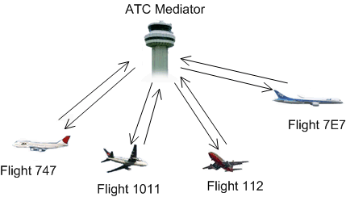
Mediator Pattern

Slide 3
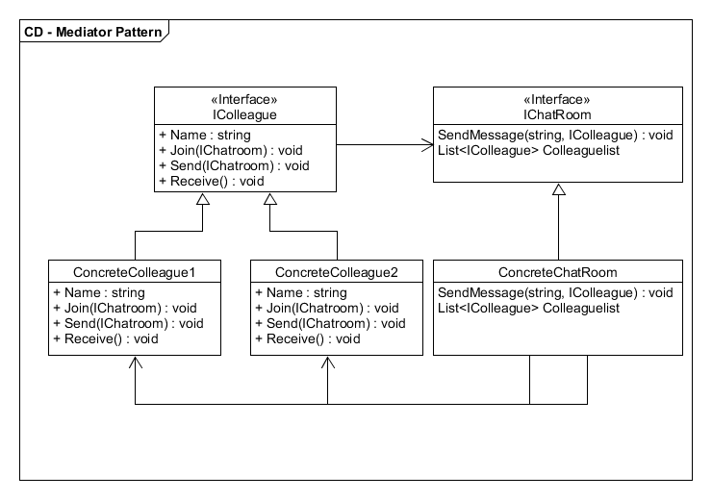
Opgaven

Slide 4
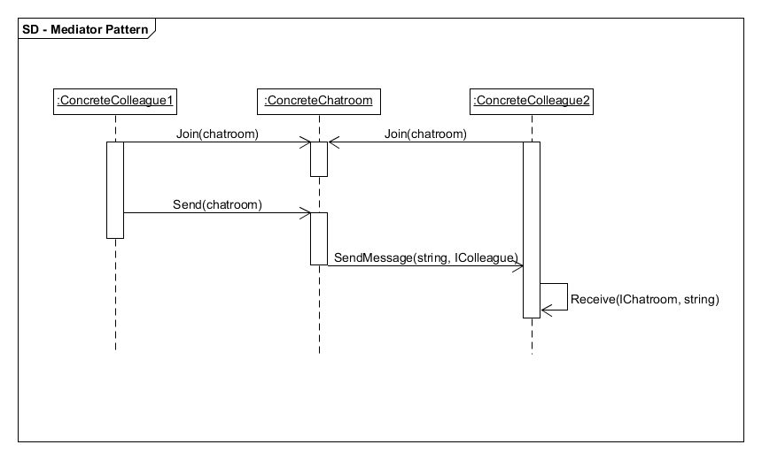

Slide 5
Demo

